Slide 1
“At the travel agency”
Выполнила:
преподаватель
иностранного языка
Клестова В. С.

Slide 2
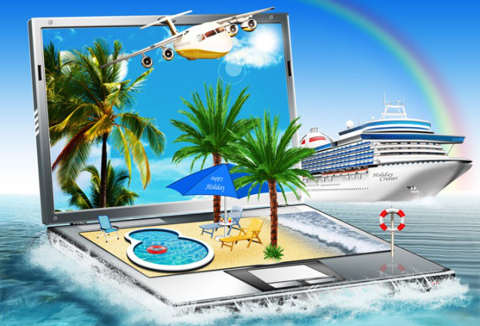

Slide 3
1) Visiting the Great Barrier Reef.
2) Going to Africa to give food to the children.
3) Flying to China to learn Chinese.
4) Visiting Australia to surf the big waves.
5) Travelling to Paris, then leaving for Amsterdam, then visiting London and Cardiff.
6) Going to Israel to get some new medicine.
7) Spending summer at the Black Sea.
8) Walking along the Great Canyon in America with good friends and a big rucksack with you.
Types of tourism

Slide 4
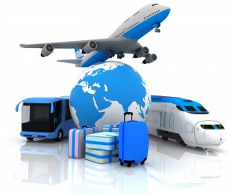
Ways of travelling

Slide 5
Travel agent qualities
1. Оказать квалифицированную помощь. 2. Координировать расписание клиента. 3. Продать билеты на самолёт. 4. Иметь хорошие навыки собеседования, телефонного разговора, работы с компьютером. 5. Сбалансировать желания клиента с реальным бюджетом. 6. Освоить много видов информации | a) To balance client dreams with real budget; b) To coordinate the customers’ schedule; c) To have good interview, telephone, computer skills; d) To sell airline tickets; e) To master many kinds of information: geography, visa regulations, types of tourism; f) To give experienced help.

Slide 6
Mike: Hello, I need to schedule my trip to Paris for next week?
Henrita: When would you like to travel?
Mike: I have to reach Paris by the 24th.
Henrita: Is this a round trip? Will you need a return ticket, too?
Mike: Yes. Check that for 31st in the evening.
Henrita: Yes, there’s a nonstop flight to Paris from Kennedy airport on 24th at 6AM. On 31st you may board flight 309 which is also nonstop at 4:30PM.
Mike: Okay, fine. I think that can work for me.
Henrita: Would you like to book the tickets then?
Mike: What’s the cost?
Henrita: It’ll be $2750.
Mike: Do you accept cards?
Henrita: Yes, we do.
Booking a ticket

Slide 7
Mike: I’d like to book a hotel in Paris, please.
Henrita: Sure, we can help you find a great place.
Mike: Well, I need a budget hotel that’s near the marketplaces.
Henrita: Certainly, just give me a sec...Okay, here’s one. It’s the Belladonna on Locke Avenue.
Mike: What are the rates for 1 person?
Henrita: It costs $150 per night. The room is big and has one queen size bed.
Mike: Okay, book that for 3 nights then, from 24th to 26th of this month.
Henrita: Certainly Sir, is there anything else I could help you with?
Mike: That’d all for now, thank you!
Booking a hotel

Slide 8
1. Type of tourism.
2. Place of vacation.
3. Time.
4. Way of travelling.
5. Hotel.
Planning a trip

Slide 9
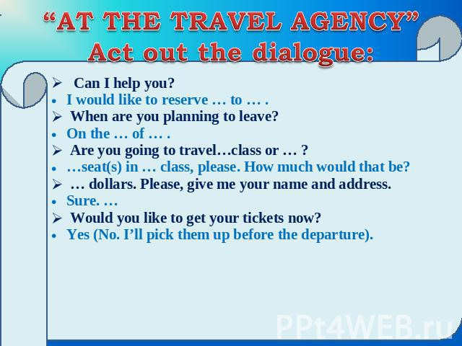

Slide 10
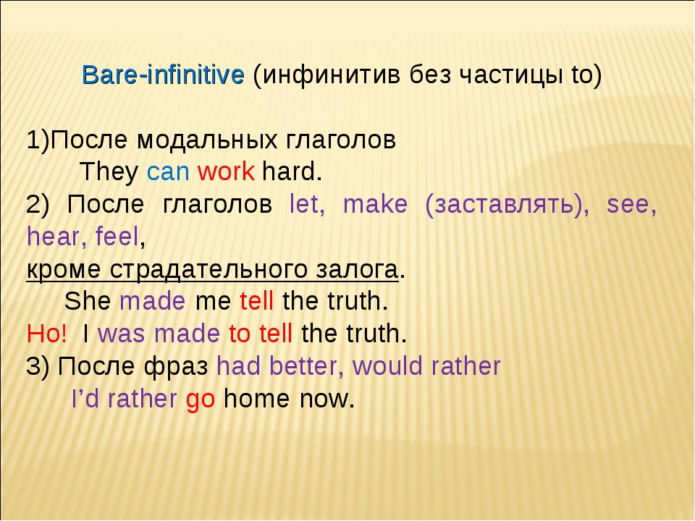

Slide 11
Customer enquiry form
Resort
Transport From… - To… Departure on … - Return on… Departure time… - Arrival time…
Name, Surname
Contact phone number
Hotel

Slide 12
to need — to call — to make — to help — to go
Have you ever made plans for a vacation? There are many things to do ahead of time. For example, it’s important (1) __ hotel reservations. It is also essential (2) __ the airline to make sure your flights are arranged. You also (3) __ to take appropriate clothing for the climate of your destination. Sometimes, it is a good idea (4) __ to a travel agent. They can (5) __ you solve any problems related to your trip.
Grammar task: fill in the gabs with the correct form of the Infinitive

Slide 13
What new facts have you learnt on this lesson?
What stages of the lesson did you like most of all?
What was difficult for you?
What skills did you improve?
The lesson is coming to the end

Slide 14
To write down the composition “Interesting places for visiting”
Hometask

Slide 15






