Slide 1
Мультимедийное сопровождение интеллектуальной игры
«To the blackboard»
Курочкина Оксана Анатольевна
учитель английского языка
МБОУ Гимназия №3

Slide 2
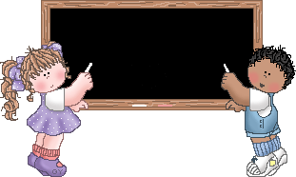
To the blackboard

Slide 3
English
Literature
History
Music
Geography
Russian
Biology
Maths
3
4
5
3
4
5
3
4
5
3
4
5
3
4
5
3
4
5
3
4
5
3
4
5

Slide 4
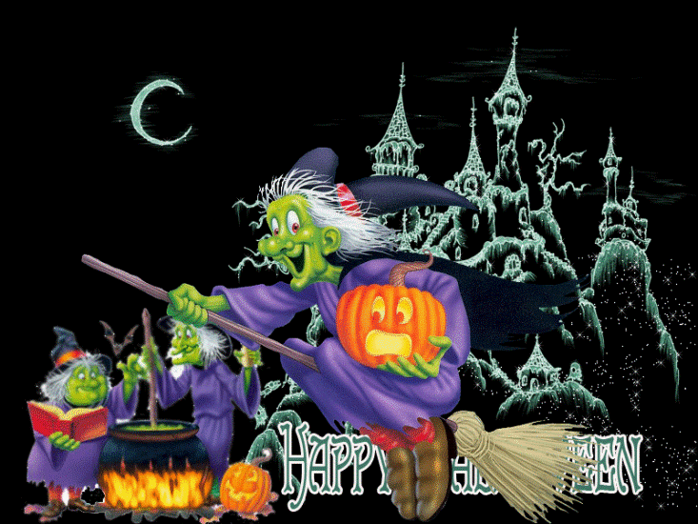
English 3
British children like Halloween which is celebrated on the 31 of October. What do they usually say at Halloween?
«Be healthy and wealthy!»
2. «Good for you!»
3. «Trick or treat?»

Slide 5
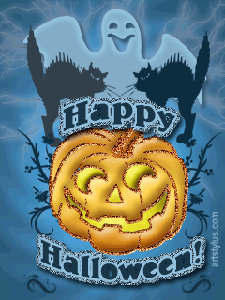
Answer
«Trick or Treat?»

Slide 6

English 4
How many letters are there in the English ABC?

Slide 7
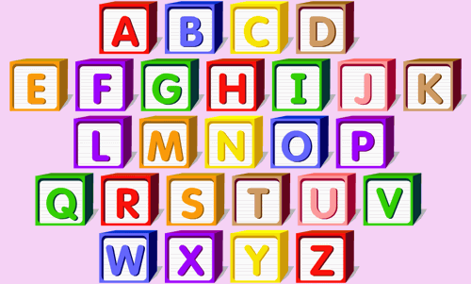
Answer
Twenty-six letters

Slide 8

English 5
Continue the lists of Plural:
fox-foxes,
child-…?
woman-…?
mouse-…?
tooth-…?
sheep-…?

Slide 9
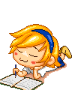
Answer
child - children
woman – women
mouse – mice
tooth –teeth
sheep- - sheep

Slide 10

Literature 3
What book is based on the adventures of a sailor Alexander Selkirk?

Slide 11
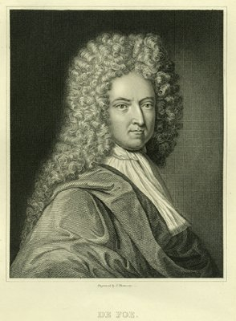
Answer
«Robinson Crusoe»
D. Defoe

Slide 12
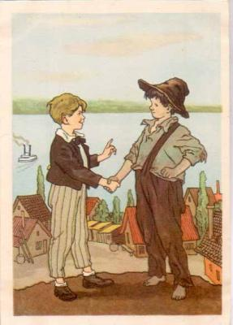
Literature 4
“The adventure of Tom Sawyer” made this American writer famous. He wrote a lot of humour stories. Who was he and what is his real name?

Slide 13
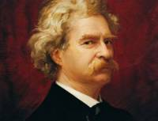
Answer
Mark Twain - nickname
Samuel Clemens - real name

Slide 14

Literature 5
This English writer was a young doctor first . Then he began to write detective stories. His two fictional friends lived at 221 B Baker Street . What writer had these detectives?

Slide 15
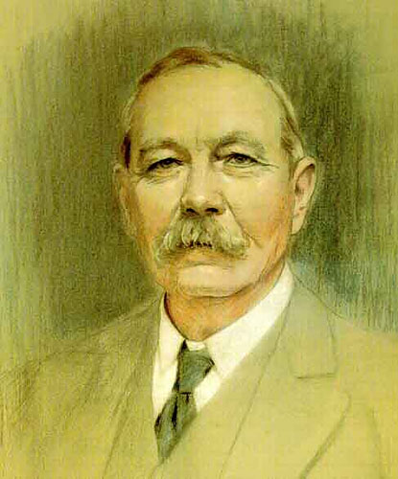
Answer
Conan Doyle

Slide 16

History 3
They were born in ancient times, but then they were forgotten. Now they are held each four years only in summer and in winter. What event is spoken about?

Slide 17
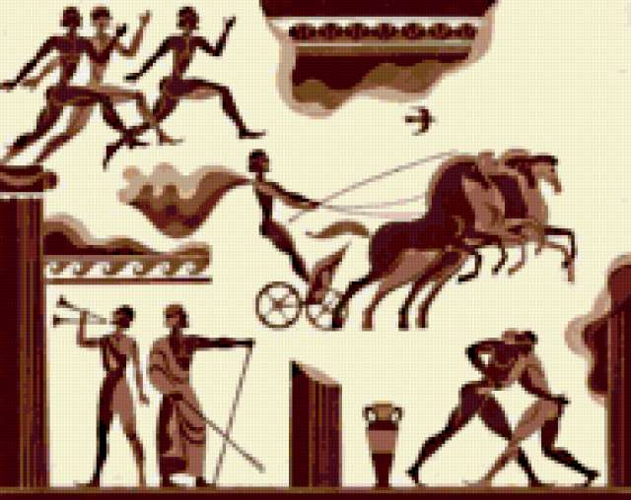
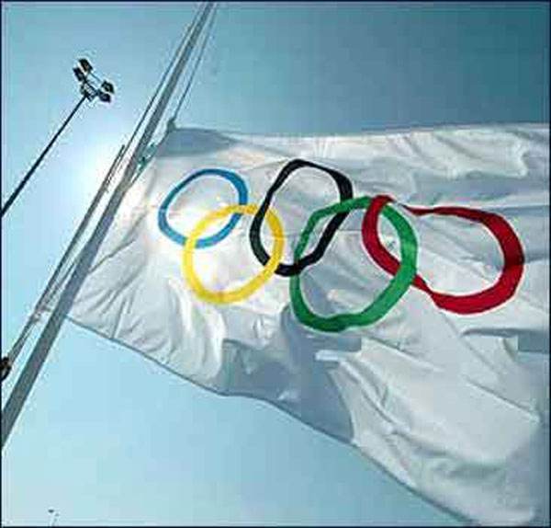
Answer
Olympic Games

Slide 18

History 4
This woman was a very good student to study chemistry. Soon she decided to study laws. Then she was involved in politics and became the first British woman Prime Minister. What is her name?

Slide 19
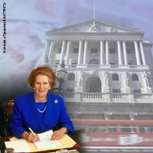
Answer
Margaret Thatcher

Slide 20
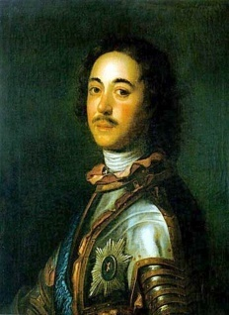

History 5
The order of this holiday was signed by Peter the First in 1700. There were fireworks during the holiday, the gates were decorated with flowers and branches. What holiday was it?

Slide 21
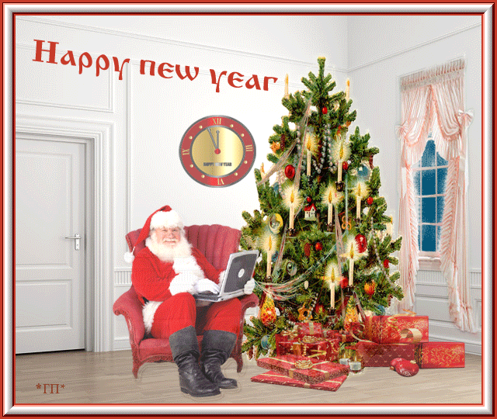
Answer
New Year

Slide 22
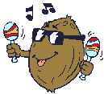
Music 3
This group is from Liverpool. They were four. They were very popular in 1960-s. What group is it?

Slide 23
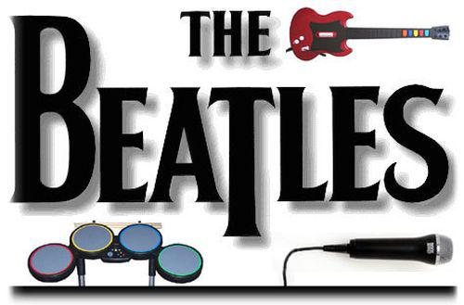
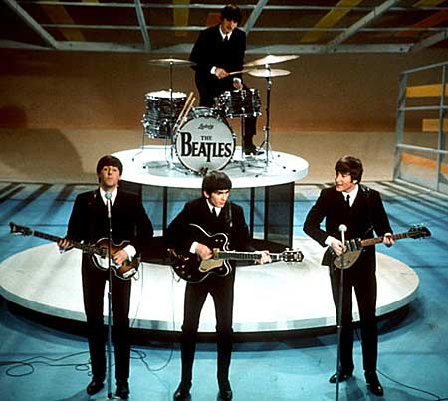
Answer

Slide 24
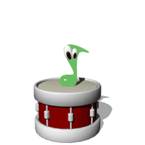
Music 4
Young people like to listen to rock music . Can you name “the King of Rock”?

Slide 25
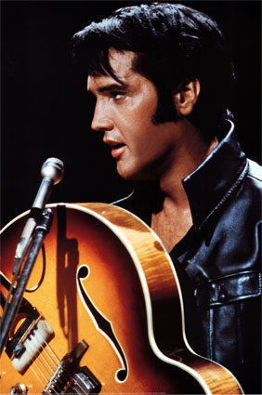
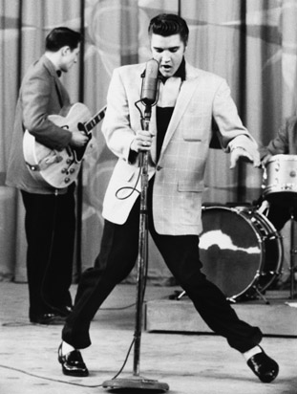
Answer
Elvis Presley

Slide 26

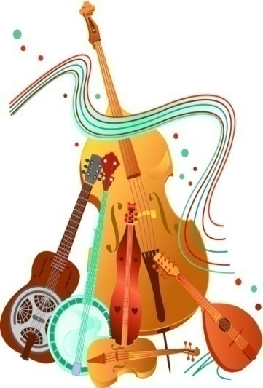
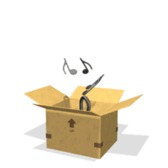
Music 5
Scottish people like music very much, the inhabitance of each village have their choirs. What is their national instrument?

Slide 27
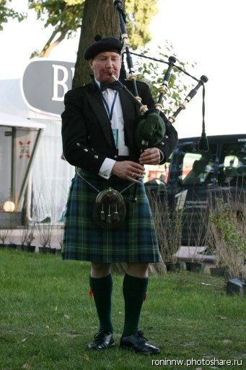
Answer
Bagpipe

Slide 28

Geography 3
What desert has a girl’s name and the status of winner?

Slide 29
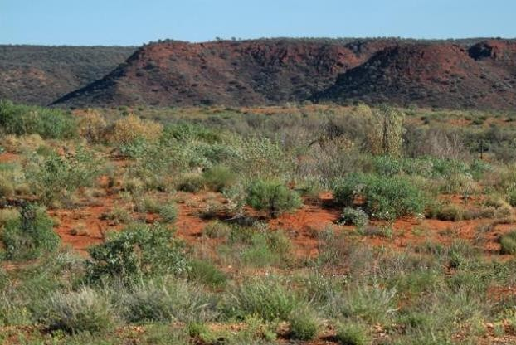
Answer
Great Victoria Desert

Slide 30
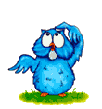
Geography 4
This country is called a land of blue mountains and sometimes “the lucky country”. It’s the smallest continent, an island and a country. What country is it ?

Slide 31
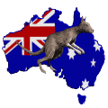
Answer
Australia

Slide 32

Geography 5
The capital of England is London, Edinburgh is the capital of Scotland, Belfast is associated with Northern Ireland. What is the capital of Wales?

Slide 33
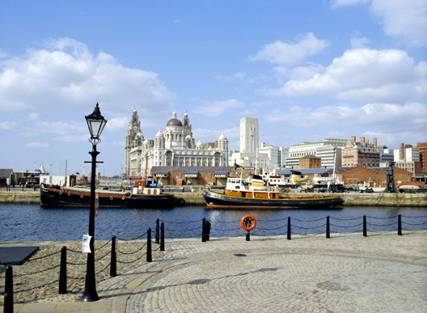
Answer
Cardiff

Slide 34
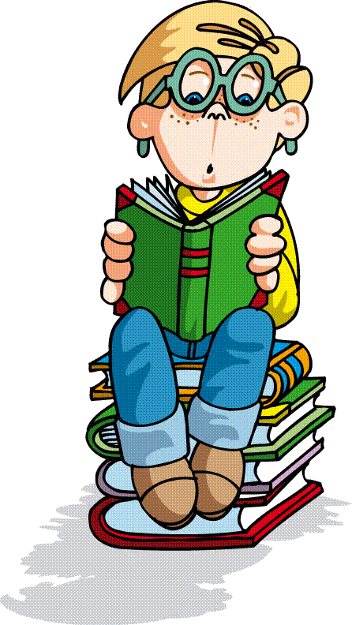

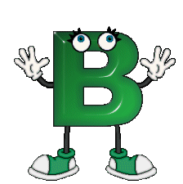
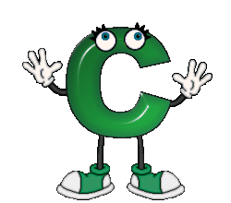
Russian 3
The English ABC has twenty-six letters. How many letters are there in Russian ABC?

Slide 35
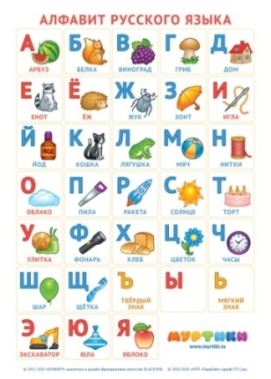
Answer
Thirty-three letters

Slide 36

Russian 4
What is the Russian equivalent of the English proverb «A cat in gloves catches no mice»?

Slide 37
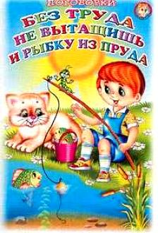
Answer
«Без труда не вытащишь
и рыбку из пруда»

Slide 38


Russian 5
What Russian word has 5 letters «o»?

Slide 39
Answer
опять

Slide 40

Biology 3
This bird has the same name as one of the fruit. It is the national emblem of New Zealand. What is it?

Slide 41
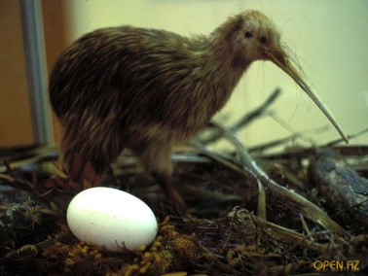
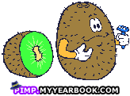
Answer
Kiwi

Slide 42
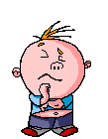
Biology 4
What plants for buckets were sent by the United Kingdom of Great Britain and Northern Ireland?
1. daffodil a) England
2. shamrock b) Scotland
3. rose c) Wales
4. thistle d) Northern Ireland

Slide 43
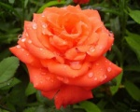
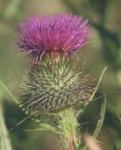
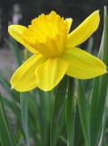
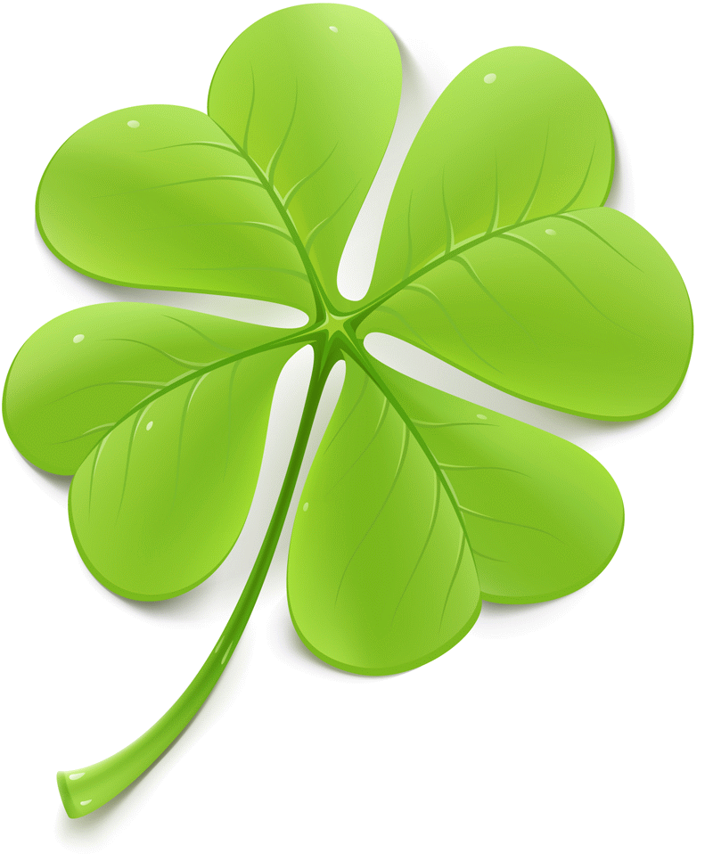
Answer
England – rose
Scotland – thistle
Wales – daffodil
Northern Ireland - shamrock

Slide 44
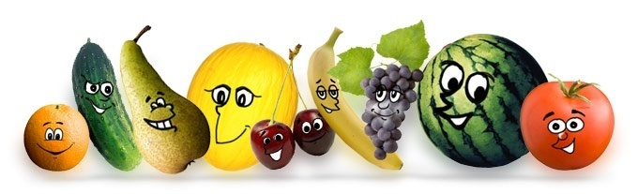
Biology 5
The name of this fruit is German by its origin, it means «Chinese apple». What fruit is it?

Slide 45
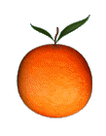
Answer
Orange

Slide 46
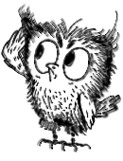
Maths 3
A cockerel standing on one leg weighs 3 kilo. What is its weight if it is on two legs?

Slide 47
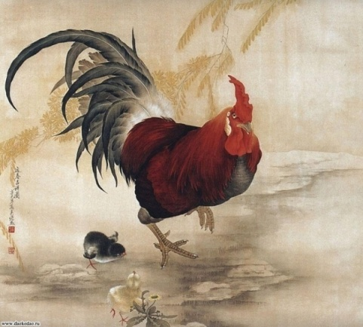
Answer
3 kilos

Slide 48
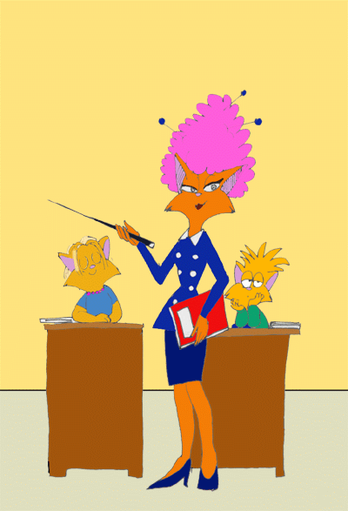
Maths 4
A father has got 6 sons, every son has one sister. How many children has father got?

Slide 49
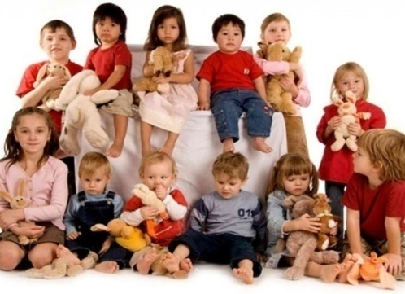
Answer
Seven children

Slide 50
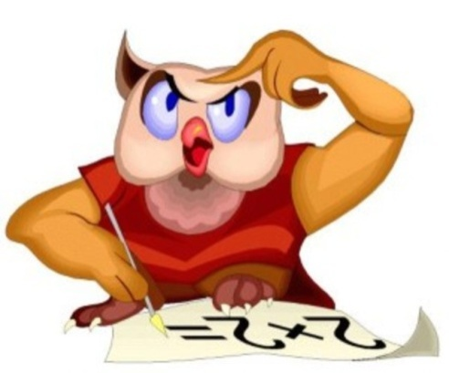
Maths 5
What is the hundredth part of metre?

Slide 51
Answer
1 centimetre

Slide 52
History and Biology
Geography and Literature
Art and History
Literature and Maths
Literature and Economics
Music and Physical Education

Slide 53
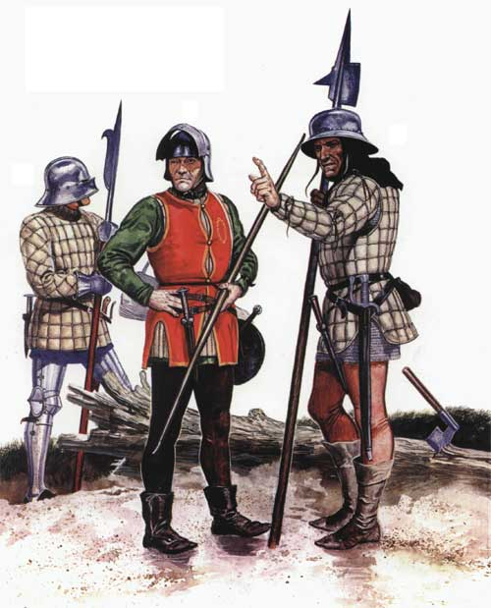
History and Biology
There are a lot of beautiful plants and flowers. What flower was associated with the horrible word «war»?

Slide 54
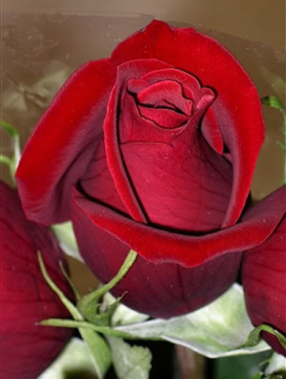
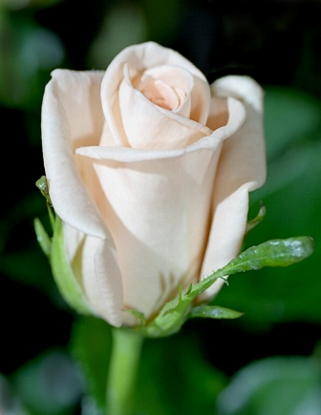
Answer
Rose
The Wars of the Roses
(15-th century)

Slide 55


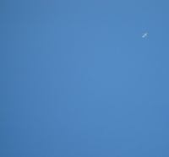


Art and History
National flags are not only symbols of a country. Their colours and designs convey past history and future goals. What colours can’t you see on the English flag?

Slide 56

Answer
Green and Blue

Slide 57

Literature and Economics
You know the book «Pinocchio’s adventures» from your childhood. What currensy (денежная единица) is used by the characters of the book?

Slide 58

Answer
S o l d o

Slide 59


Geography and Literature
What part of Great Britain inspired the great poet Robert Burns to write his verses?

Slide 60

Answer
Scotland

Slide 61


Literature and Maths
This English writer was a mathematician first and then he helped Alice to travel and have fun in Wonderland. Who is this writer? What was his real name?

Slide 62

Answer
Lewis Carroll is his nickname.
Charles Dodgson is his real name.

Slide 63

Music and Physical Education
These Games began in Scotland a thousand years ago. They include contests in racing, athletics, sheepdogs trials and also music and dancing competitions. What Games are they?

Slide 64




Answer
Highland Games

