Slide 1
Как сравнить две фотографии на английском языке
(ЕГЭ, задание 4)
по опциям

Slide 2
Task 4. Study the two photographs. In 1.5 minutes be ready to compare and contrast the photographs:
- give a brief description (action, location)
- say what the pictures have in common
- say in what way the pictures are different
- say which kind of life you’d prefer
- explain why
You will speak for not more than 2 minutes. You have to talk continuously.

Slide 3
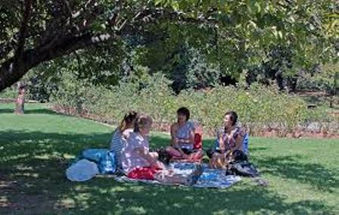
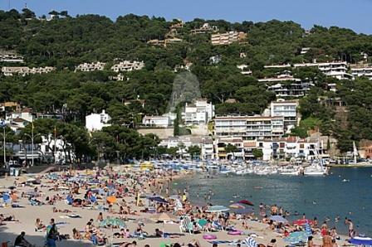
(0) I would like to compare and contrast two photos.
2) Describing the second picture
In the second picture there are a lot of people sunbathing on the beach. In the background we can see lots of apartments. The beach is really crowded.
1) Describing the first picture
Let me see. In the first picture I can see a group of people sitting under a big tree. It looks like summer and everyone looks relaxed.

Slide 4
3) Сравниваем две фотографии: что общего / Comparing the pictures
Obviously, the pictures were taken in the summer time and maybe the common theme is about what people like doing on holidays.
The pictures are similar because they both show …

Slide 5
4) Сравниваем две фотографии: чем отличаются / Contrasting the pictures
There are a couple of (several) differences between the photos. The scene in the first picture looks very peaceful. On the other hand, the beach scene looks very noisy and chaotic.
The other is that the person on the left is …. while the person on the right … . Also, …. Furthermore, …

Slide 6
5) Делаем предположения / Speculating
Maybe, the people in the second picture are on a package holiday and normally they live in cities where as the people sitting under the tree live in the country. They could be farmers or something.

Slide 7
6) В заключение, выражаем личное мнение / Personal Feelings
Personally, I’d rather be in the first photo. It looks like a perfect way to spend the summer afternoon. The scene at the beach … Well, it’s my idea of a nightmare. I mean I like going to the beach but I don’t really like crowds.
I prefer the situation with the …because …/ I would prefer to deal with … because …

Slide 8
Данное сравнение идеально соответствует опциям задания 4 (устной части ЕГЭ) за исключением одного момента — времени. Значит, нужно немного расширить собственно описание фотографий — пункт 1 и пункт 2. Для этого воспользуйтесь стандартным (полным) описанием фотографии .
Вводные слова и выражения, в том числе выражающие личное мнение:
Let me see. – Дайте подумать.
Well, … — Ну, …
Obviously, … — Очевидно …
I mean … — Я имею в виду …
On the other hand, … — С другой стороны (при сравнении фотографий)

Slide 9
Слова и выражения для описания и сравнения фотографий:
In the first picture I can see … — На первой картинке я вижу …
In the second picture there are … — На второй картинке находятся …
It looks like … — Похоже на …
The scene looks like … — Сцена выглядит …
Everybody looks like … — Все выглядят …
In the background … — На заднем фоне …
In the foreground … — На переднем фоне …
The common theme – Общее на фотографиях …
where as — в то время как (сравниваем одну фотографию с другой)
It’s my idea of a … — Это мое представление о …

Slide 10
При описании фотографий нужно обязательно показать, что владеете продвинутыми грамматическими конструкциями. Поэтому используйте:
1) Предложения в пассивном залоге
The pictures were taken in the summer time. — Эти фотографии были сделаны летом.
2) Модальные глаголы в значении предположения
They could be farmers or something. — Они, возможно, фермеры или кто-нибудь в этом роде.
3) Причастия (действительные и страдательные)
In the first picture I can see a group of people sitting under a big tree. — На первой фотографии я вижу группу людей, сидящих под деревом.
In the second picture there are a lot of people sunbathing on the beach.
4) Конструкции предпочтения
I’d rather be in the first photo. — Я предпочел бы быть на первой фотографии.

Slide 11
Тренируем умение сравнивать фото
(ЕГЭ, задание 4)
по опциям

Slide 12
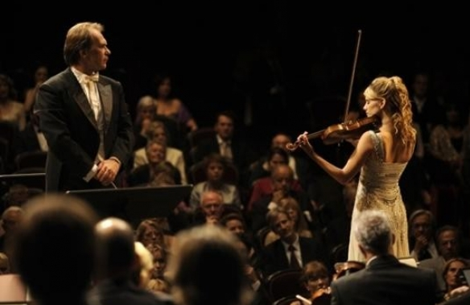
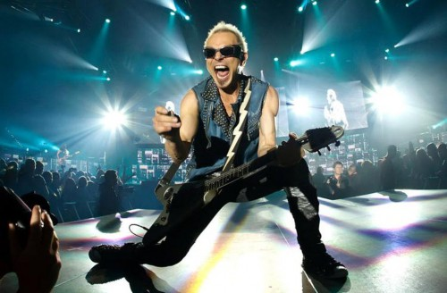
give a brief description of the photos (action, location)
• say what the pictures have in common
• say in what way the pictures are different
• say which of the pictures you’d prefer
• explain why
Conductor –дирижер, audience – публика

Slide 13
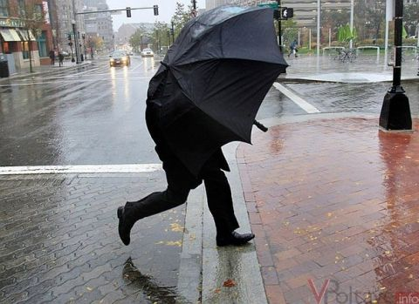
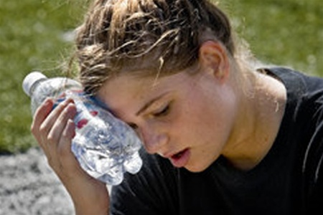
give a brief description of the photos (action, location)
• say what the pictures have in common
• say in what way the pictures are different
• say which of the pictures you’d prefer
• explain why
The man is struggling with the wind
To cope with different types of weather

Slide 14
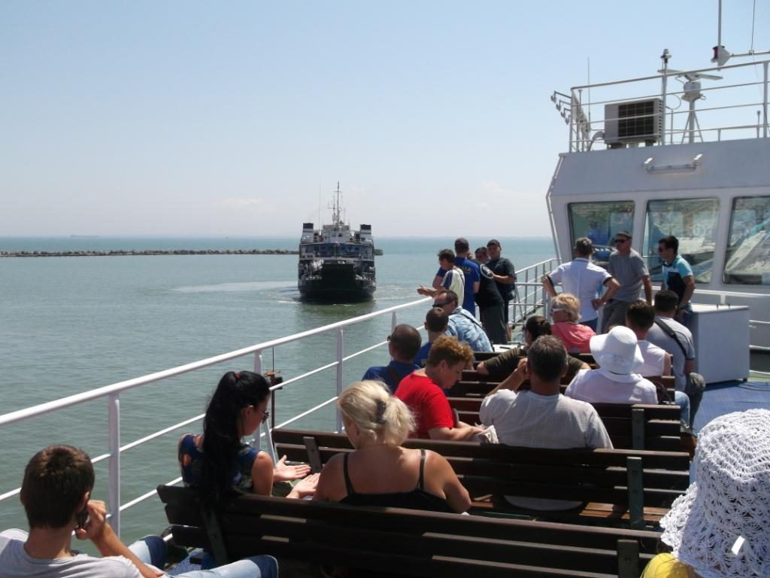
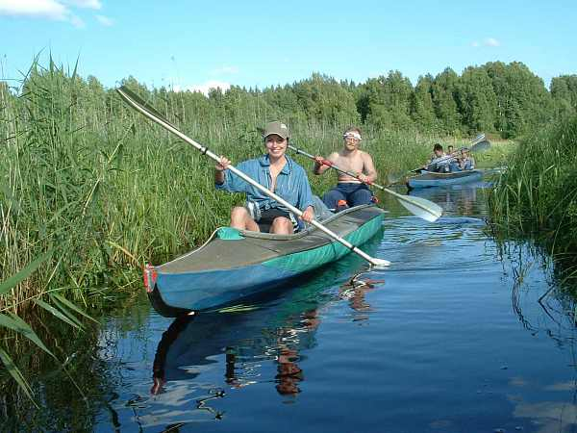
give a brief description of the photos (action, location)
• say what the pictures have in common
• say in what way the pictures are different
• say which of the pictures you’d prefer
• explain why

Slide 15
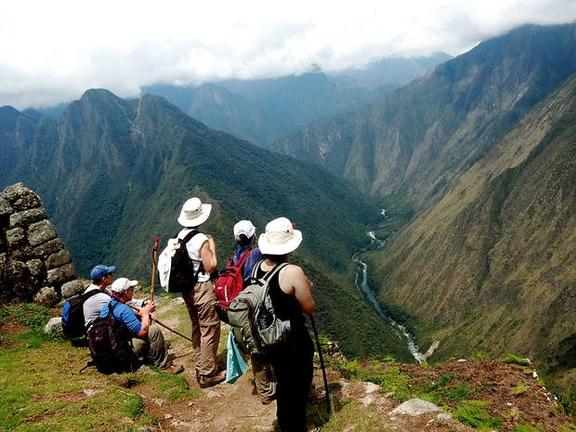
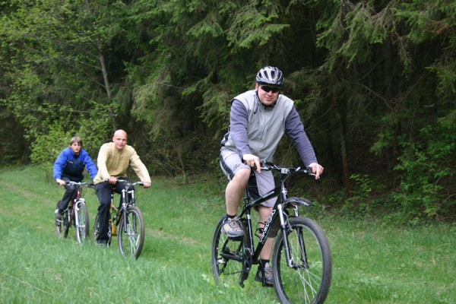
give a brief description of the photos (action, location)
• say what the pictures have in common
• say in what way the pictures are different
• say which of the pictures you’d prefer
• explain why

Slide 16
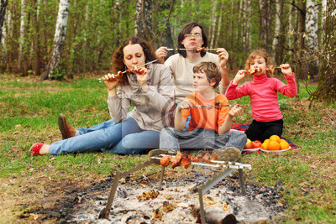
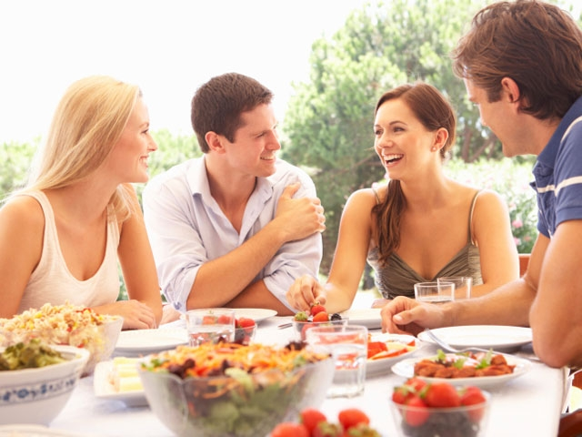
give a brief description of the photos (action, location)
• say what the pictures have in common
• say in what way the pictures are different
• say which of the pictures you’d prefer
• explain why
Enjoy the meal

